Slide 1


Design and Development of a Web Application
in a Containerized Environment
Supervisor:
Prof. Pierpaolo Baglietto
Cosupervisor:
Dott. Marco Risso
Candidate:
Fabrizio Durante
Student ID n. 3941665
Examine the popularity of disassemblers
METHODOLOGY

Slide 2
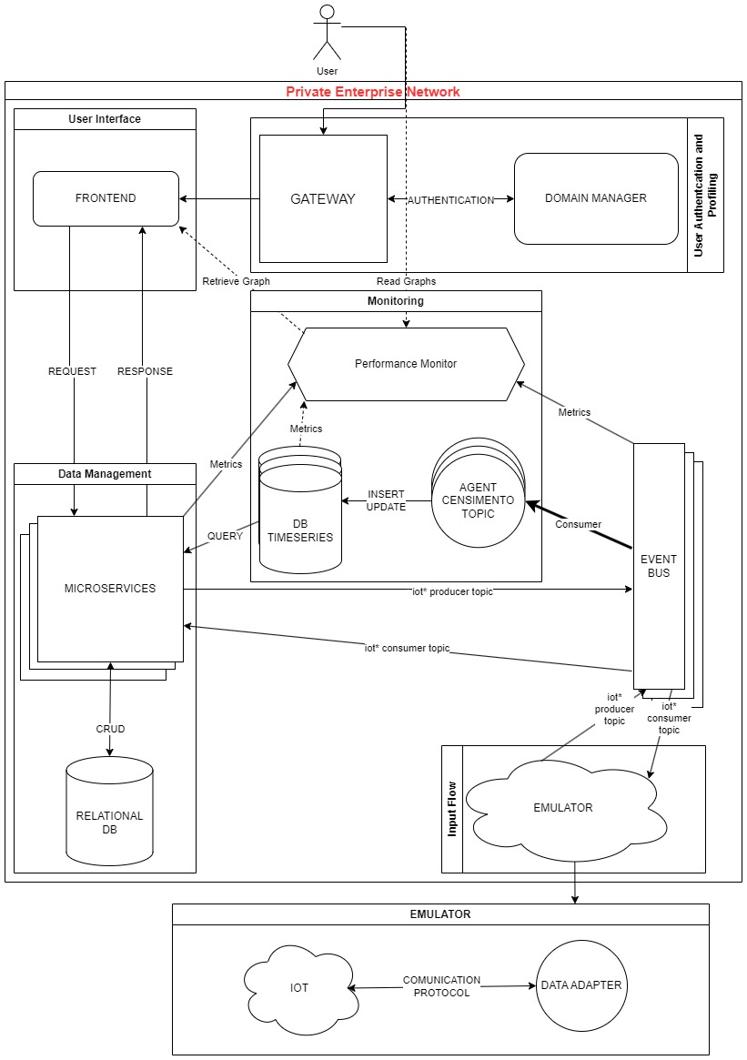
architecture
Groups:
Input Flow
Data Management
User Interface
Authentication
Monitoring

Slide 3

Core technologies

Slide 4



Event Streaming Bus

Slide 5



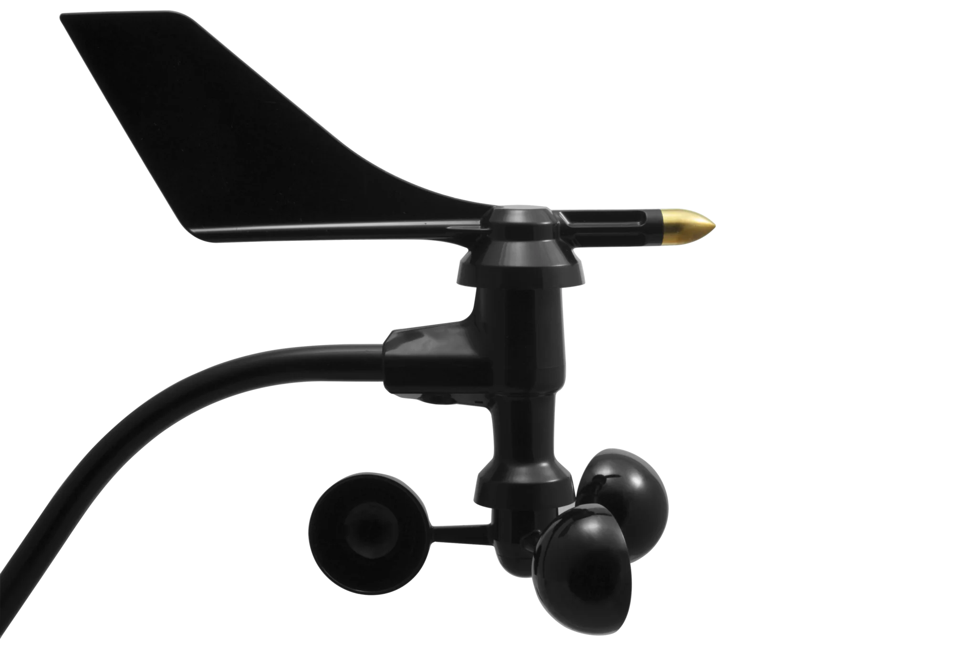

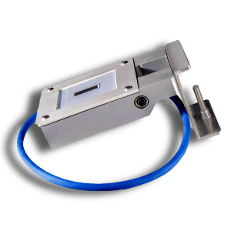

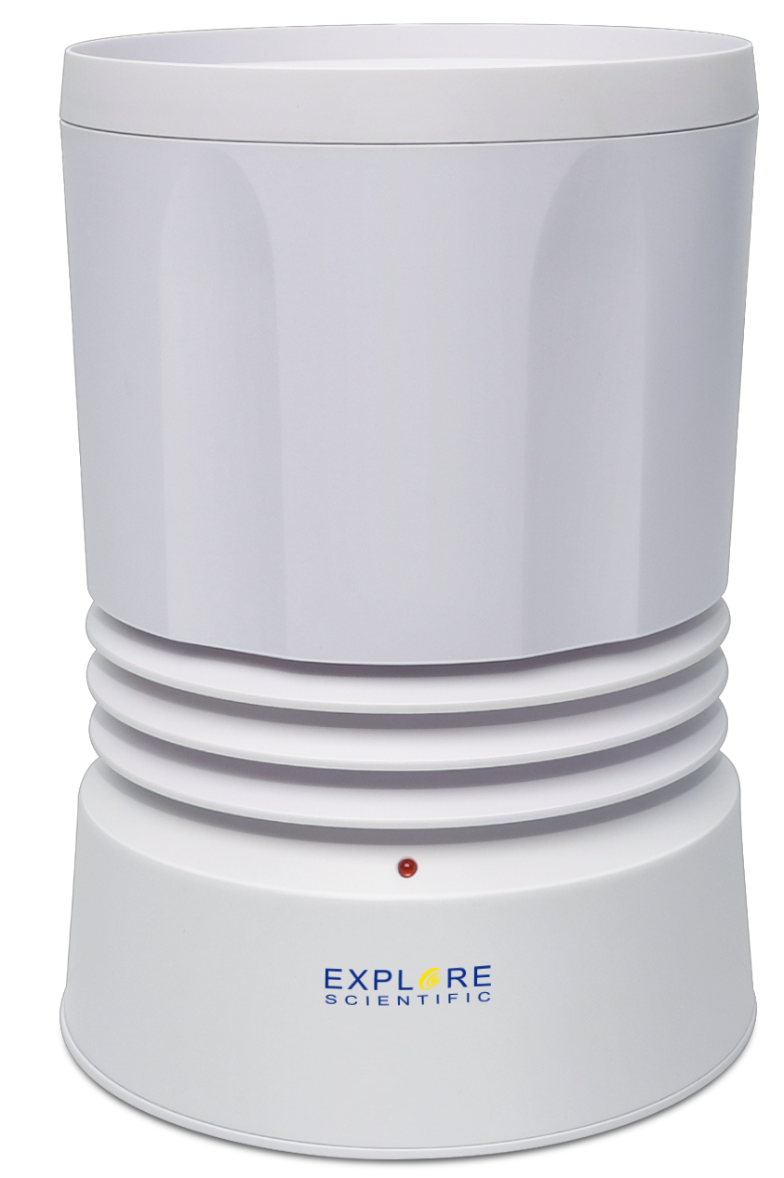

Input Flow
Adapters
AdaptersManager

Slide 6


Data Management
User Interface
User Interface
User Interface
SOCKET SERVICE
CONFIGURATION SCHEDULER
REST SERVICE
INPUT FLOW

Slide 7




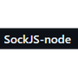
USER interface
UI
AUTHENTICATION
DATA MANAGEMENT

Slide 8


Authentication and user profiling
GATEWAY
DATA MANAGEMENT
User Interface

Slide 9






monitoring
INPUT FLOW

Slide 10




TESTing
UI

Slide 11


CI/CD PIPELINES

Slide 12
results
Login su keycloak

Slide 13
results

Slide 14
results

Slide 15
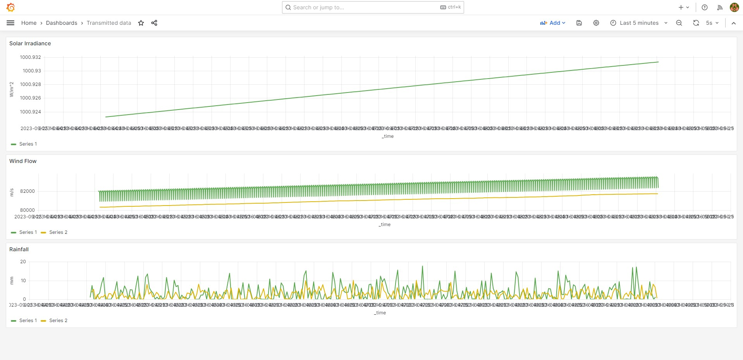
results

Slide 16
CONCLUSION
Robustness
Scalability
Reliability
User-friendliness

Slide 17
Future developments
REST SERVICE
AdaptersManager
Adapters

Slide 18
Future developments
entities
entities_old
CONFIGURATION SCHEDULER

Slide 19
THANK YOU

